Slide 1
IoT Guitar tuner
E5IOT
Status update 26-10-2018
Notes:
Hello,
This is a short presentation with a status update for the IoT Guitar tuner project, as of the 26th of October 2018

Slide 2
Status update
Hardware
Starting point and comparison
Signal analysis
Hardware setup
Software
Notes:
We will be taking a look at what has been done on the hardware and software sides and where they currently stand, as well as a few items that are still in planning.

Slide 3
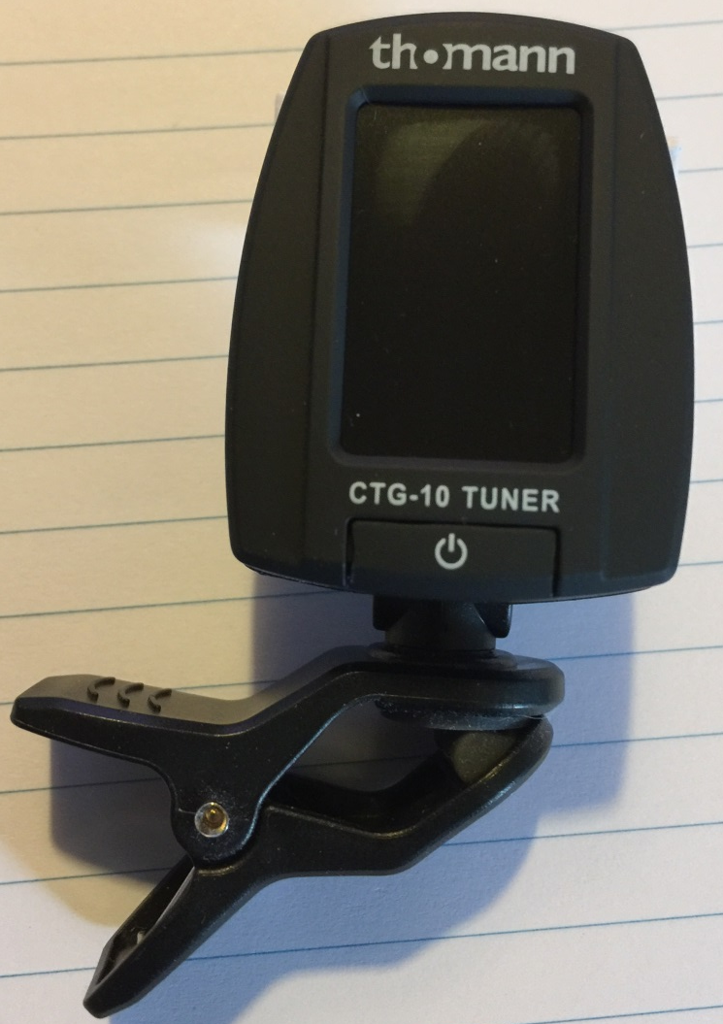
Hardware
Starting point and comparison
2 CTG-10 tuners acquired
1 for comparison
1 for modification
Uses 1 piezo disc for measurement
Notes:
To start out the hardware side 2 CTG-10 tuners have been acquired. 1 of these is to make comparison with the final product, the other is being modified to minimize the amount of actual hardware that needs to be developed. These particular tuners, detect the string vibrations using a piezo disc that is mounted on the PCB.

Slide 4
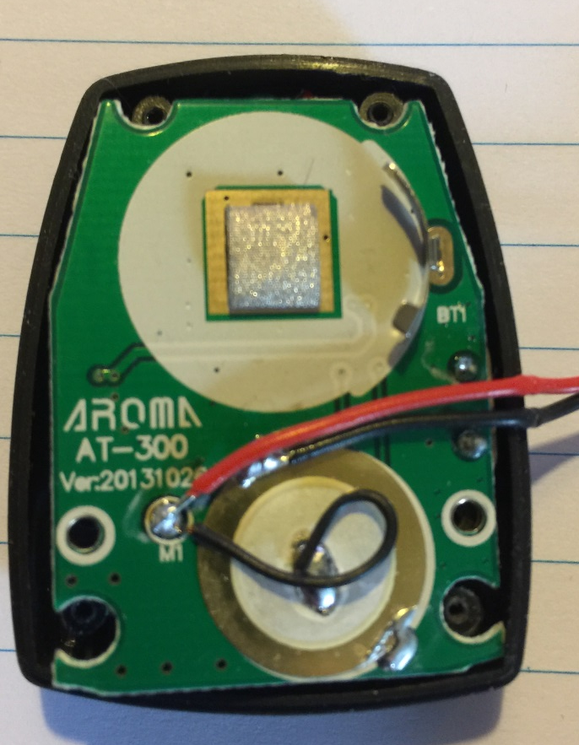
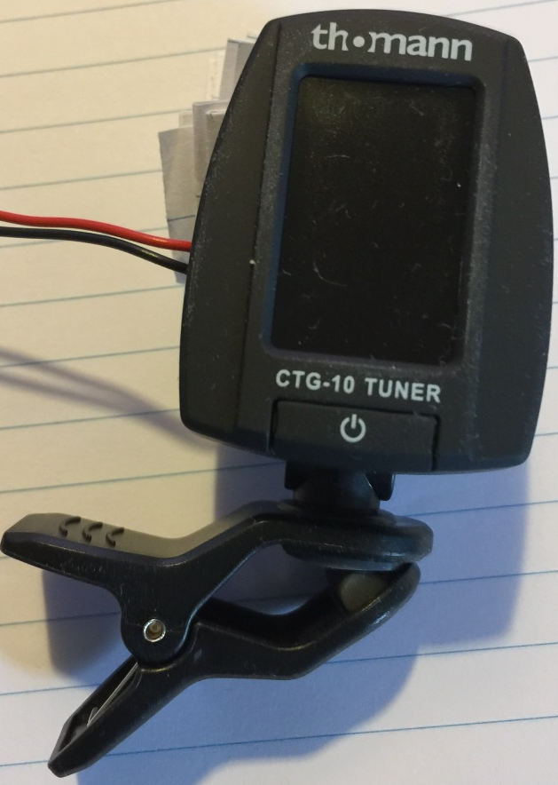
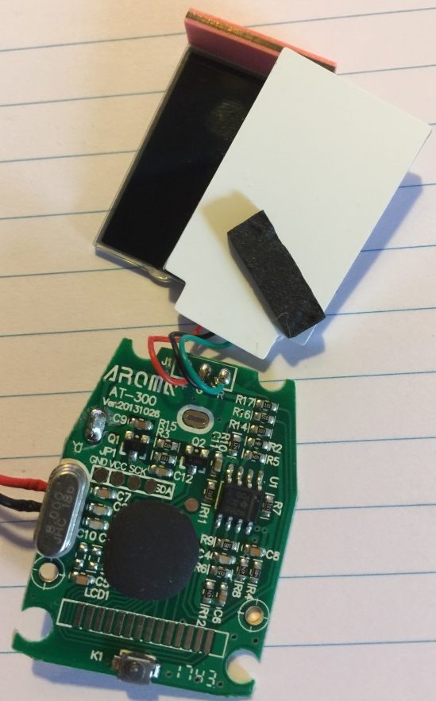
Signal analysis
Notes:
To know what signals come from the sensing element, 1 of the tuners was dismantled and 2 wires were soldered directly to the piezo element. After everything was put back together again so a comparison test with the tuner could be made, to insure the alteration had not affected the device. And also to make it easier to make the measurements on the signal.
The comparison of the 2 tuners showed a small discrepancy between them, but this same discrepancy was also present before the alteration and it is so little that it is irrelevant!

Slide 5
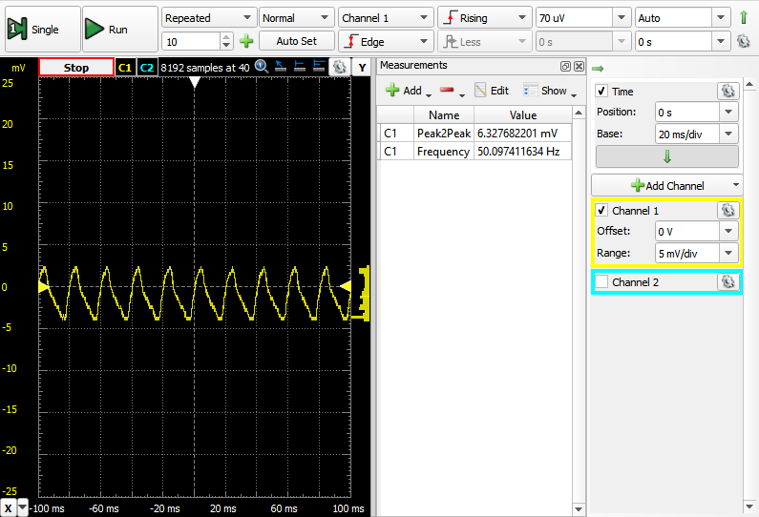
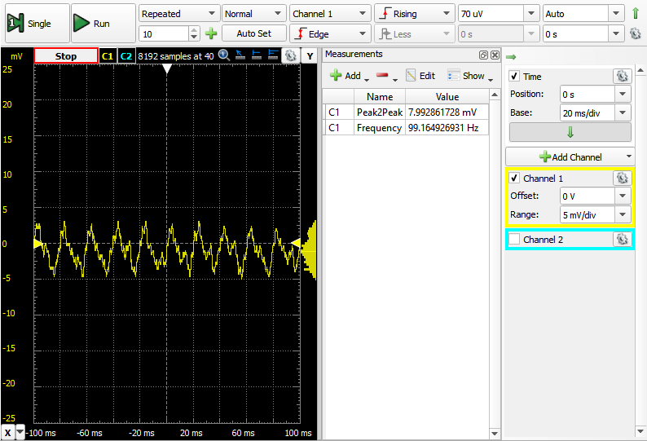
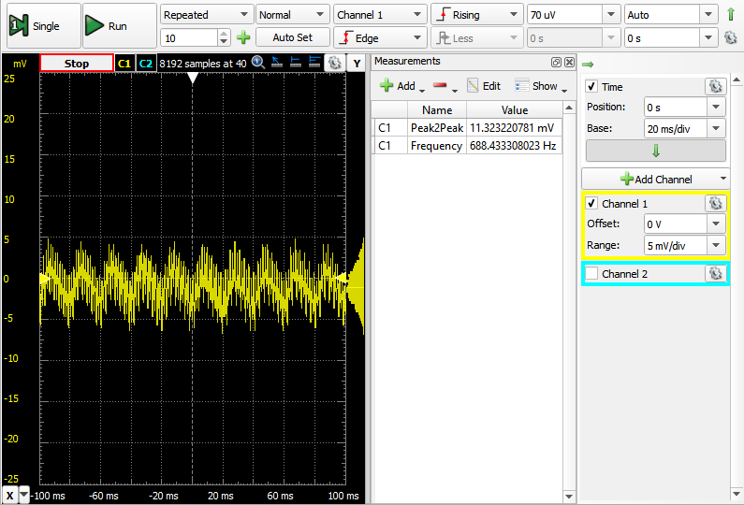
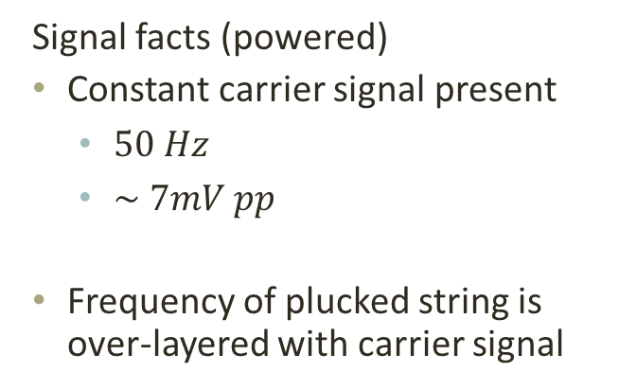
Signal facts (powered)
Constant carrier signal present
$50 Hz$
$\sim 7mV pp$
Frequency of plucked string is over-layered with carrier signal
Carrier signal
Low E string
High E string
Notes:
The first test completed was to see what kind of signal would be produced when the tuner is turned on. As is shown in the upper right hand picture, when all strings are muted there is a small signal present with a frequency of 50 Hz and an average peak 2 peak voltage of 7 mV.
The 2 other pictures show the low and high E strings being picked, here it can be seen that the frequency of the picked string get layered into the carrier signal.

Slide 6
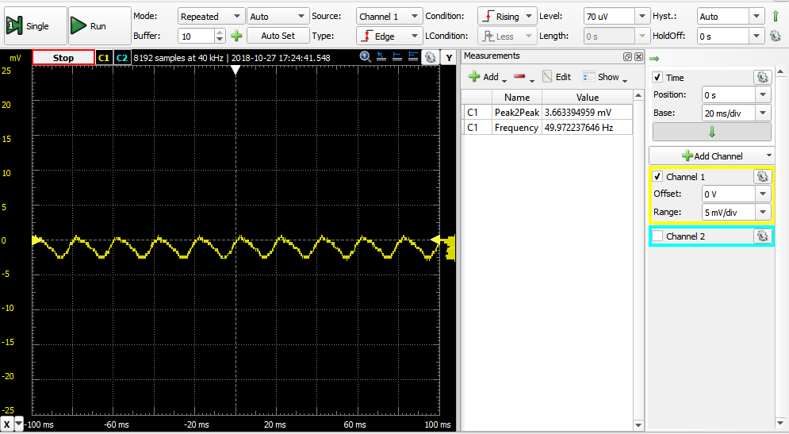
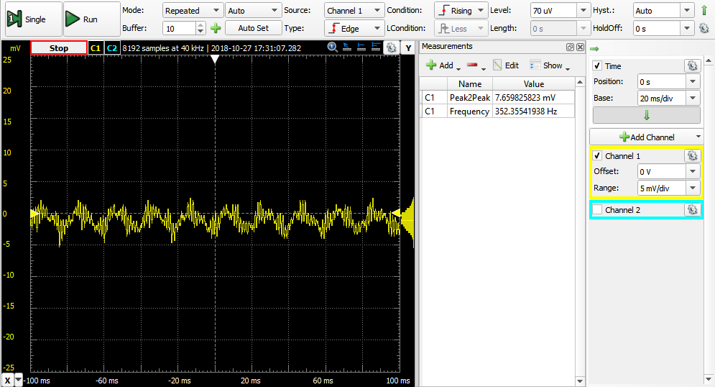
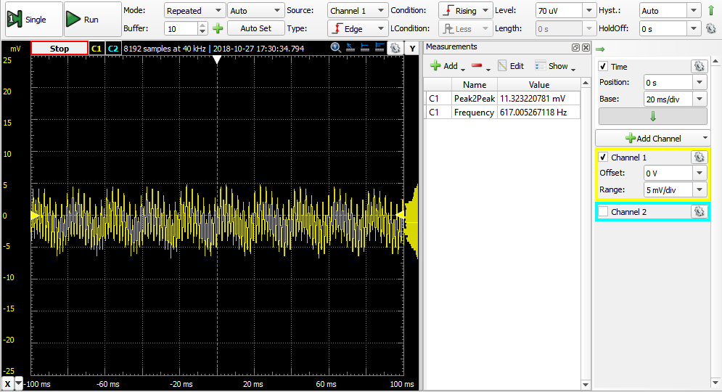
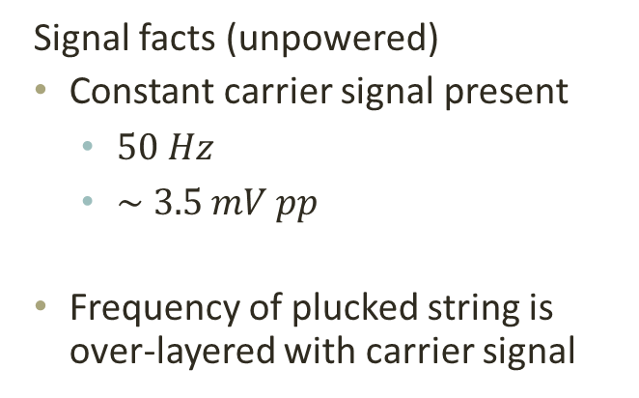
Signal facts (unpowered)
Constant carrier signal present
$50 Hz$
$\sim 3.5 mV pp$
Frequency of plucked string is over-layered with carrier signal
Carrier signal
Low E string
High E string
Notes:
The same measurements were completed with the tuner turned off. Here it can be seen that the same carrier signal is still present, it has the same frequency of 50 Hz but the peak 2 peak voltage has been roughly halved.

Slide 7
Hardware setup
In progress
Decide on powered or unpowered signal
Reverse engineer test tuner to determine if signal is amplified
COB could be an issue!
Thought for implementation
Attach and connect Photon
Build indication to user
Notes:
At the moment it need to be decided whether to use the modified tuner with or without its internal power. This decision will be based on which gives the best result when the photon needs to sample the signal. And on that same note a quick reverse engineering of the circuit in the tuner, to determine if the signal passes through some amplification before being analyzed. But since there is a Chip-on-Board present there are some parts of the circuit that cant be figured out.
Other items that needs to be completed is the connection of the sensor to the Photon and mounting of the Photon to avoid long heavy wires. And the little system to indicate to the user if the string is at the correct pitch or they need to tighten or loosen the string a bit.

Slide 8
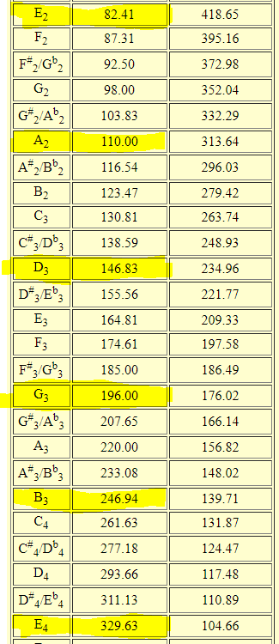
Software
In progress
Code for analog input on hand, but needs tweaking
Sample signal and send to ThingSpeak
Thought for implementation
FFT analyses to extract frequency (Matlab through ThingSpeak)
Extract correct string frequency from https://pages.mtu.edu/~suits/notefreqs.html
Compare results and indicate to user
Notes:
On the software side, a small piece of code has been written that can read an input from one of the analog pins. But the code needs a little tweaking after the sensor is connected. Current work is being made on a code that can take the sampled input and send it to ThingSpeak for analyses. ThingSpeak has been chosen as platform because this site has MatLab integration which will help in making an FFT analyses script that can extract the frequency of the picked string.
Things that still need to be started.
The Matlab script that needs to run on ThingSpeak. A way to extract the desired string frequency from the table on this site, the picture here shows the exact tones and frequencies that are needed for an E standard tuning. And lastly, both the analyzed frequency and the desired frequency needs to be compared, so the Photon can indicate to the user if the string is in tuned or needs to be tightened or loosened.

